Slide 1

Systems Level Analysis of Metabolic Perturbation in Drosophila
Manoj R. Teltumbade
Supervisor: Dr. Abhay Sharma
DAC-I
Notes:
I am going to present my proposed work on system level analysis of metabolic perturbation in Drosophila

Slide 2
Contents
Section | Slides
Introduction | 1-2
Objectives | 3
Methods | 4-6
First expected results | 7
Notes:
My presentation is split into the following contents

Slide 3
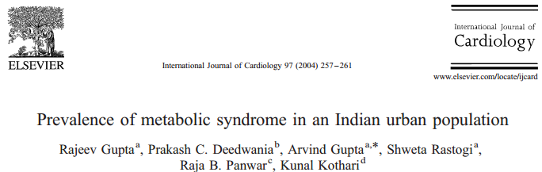
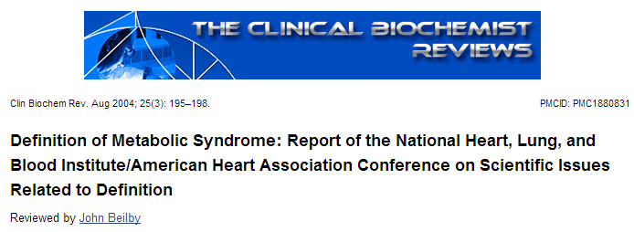
Introduction: Metabolic Syndrome
Metabolic Syndrome (MetS) is a set of multiple risk factors for diabetes and CVD that commonly appear together.
Sudden increase in MetS cases emphasizes the relevance of dietary component.
Notes:
#MetS is defined as the presence of three or more of Abdominal obesity, high Triglycerides, HDL, Blood pressure, fasting glucose
#Metabolic syndrome was present in (31.6%) subjects in a 10 year old study. Numbers have gone up rapidly in the past few decades. Which cannot be explained by genetics alone.
#Diet: Particularly carbohydrate consumption that has only gone up.
*References for increase in diabetes, and CVD in folder

Slide 4
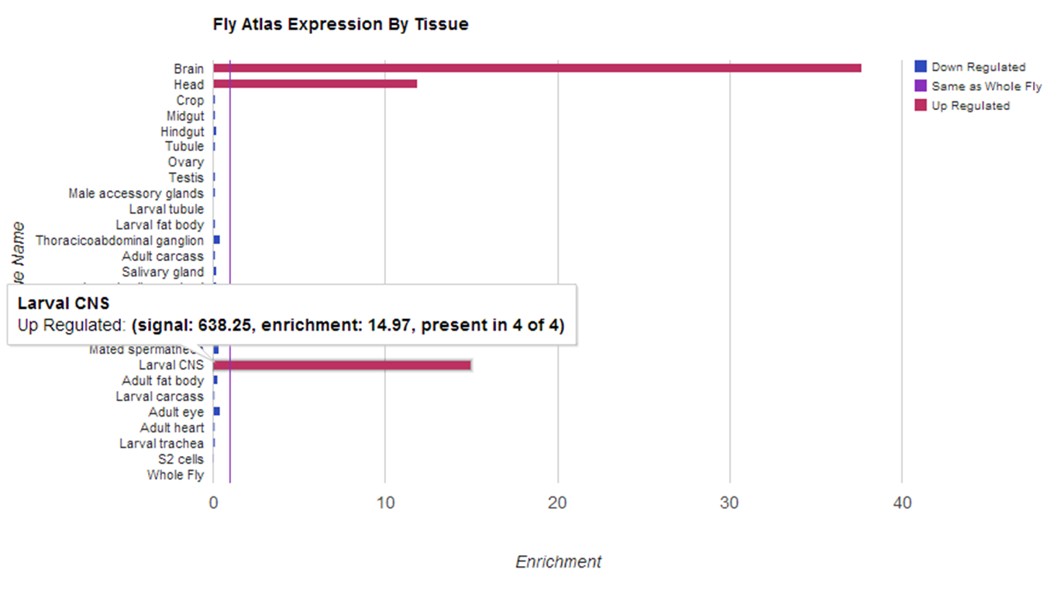
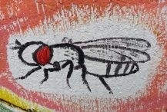
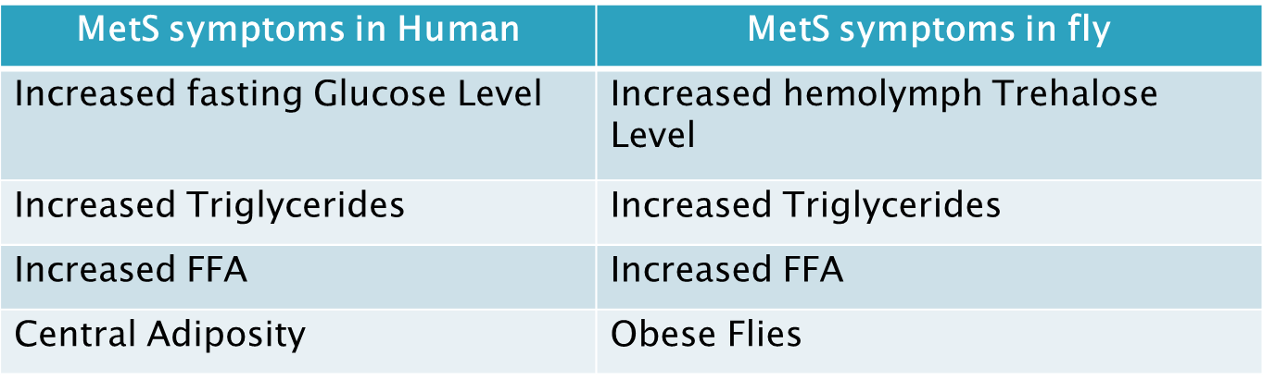
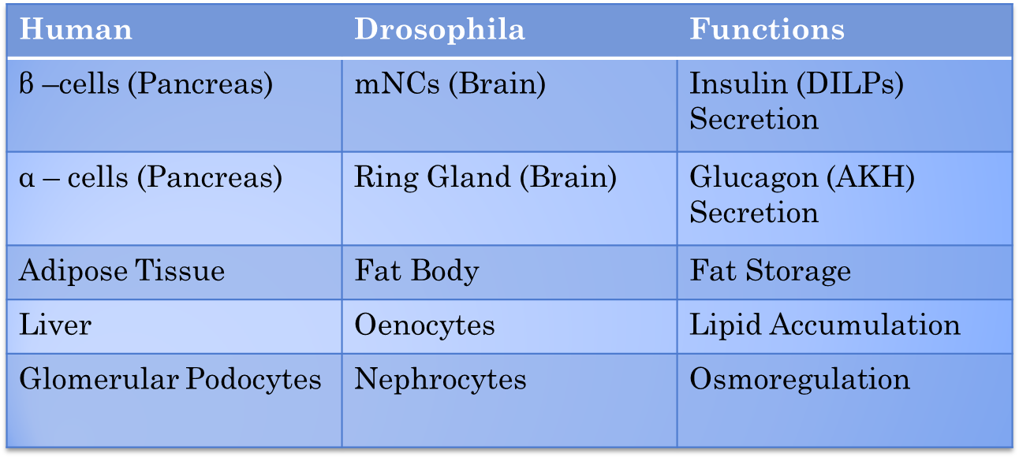

Introduction (contd.): Why Drosophila?
High-sugar induced model of MetS is well developed in Drosophila
(Musselman et al, 2011)
Homologous organ system & conserved metabolic pathways to human
(Reiter et al, 2001)
Availability of Tissue-specific Transcriptome (FlyAtlas)
(Robinson et al, 2007;2013)
Atlas picture
Availability of Tissue-specific Metabolome
(Chintapalli et al, 2013)
Sexual dimorphism in metabolic diseases in drosophila can be studied
(Mittaltrass et al, 2011; Linder et al,2004)
e.g. dilp 2
Notes:
#Table showing correspondence of metabolic assays performed in drosophila and those used in diagnosing MetS in humans
#As much as 75% of “disease causing genes” have direct orthologs in drosophila. I have further made a table showing the drosophila counterparts of various organs and hormones. The hormones counterbalance each in drosophila much like they do in humans.
#Here is a snapshot of the drosophila insulin like peptide 2: the atlas shows its enrichment in brain and head suggesting equivalence between brain ISCs and pancreas
# Reference/snapshot for metabolome
# There are logistical advantages to using a small model organism but unlike in other small models like c. elegans you can study dimorphism in drosophila

Slide 5
Objectives
2. Study transcriptomic alteration in relevant tissues
3. Shortlist enriched /downregulated genes by comparing with previous GWAS candidates
4. Functionally validate shortlisted genes in MetS background
1. Induce MetS in flies through diet
Notes:
My overarching objective is to find out if there is an overlap between genes perturbed after high dietary intake of sugar and those discovered from GWAS of MetS.
If there is indeed such an overlap it would be doubly helpful:
Help us in ruling out false positives with the mutually reinforcing evidence
Would provide more support for gene-environment interaction model of disease development

Slide 6



Methods: 1. Inducing MetS in flies through diet
3-4 days old
adult flies
Normal Diet
Male
Female
Male
Female
High-sugar Diet
Assays of various metabolites
Control
HSD
Image source: www.google.com
Notes:
We take three-four days adult flies to rule out developmental effects/confound. We divide them into control and treatment group. Although, my treatment is food containing high sucrose, other groups have also looked at high fat, we may do that in the future. After three weeks—equivalent to midlife in humans—we conduct assays to measure the levels of various metabolites such as glucose, glycogen and TAG using kits made for clinical diagnostic.

Slide 7
Methods: 2&3. Tissue-specific transcriptomic analysis
Treatment Groups
Control Male
Tissues Dissection
Brain
RNA extraction
HSD Male
Control Female
HSD Female
Fat Body & Oenocytes
Muscles
Transcriptome
Profiling
Three Biological Replicates (min.)
Comparison with previous GWAS candidates
Notes:
#After inducing metabolic dysfunction in flies I would dissect out tissues that are central to homeostasis in Drosophila like the brain and isolate RNA from them.
#Once I identify preferentially upregulated or downregulated genes through transcriptomic profiling, I will search the existing GWAS literature to shortlist genes common to both. I will functionally validate shortlisted genes by using genetic tools.
*Microarray versus RNA sequencing: RNA seq is cheaper and requires less RNA, can distinguish isoforms

Slide 8
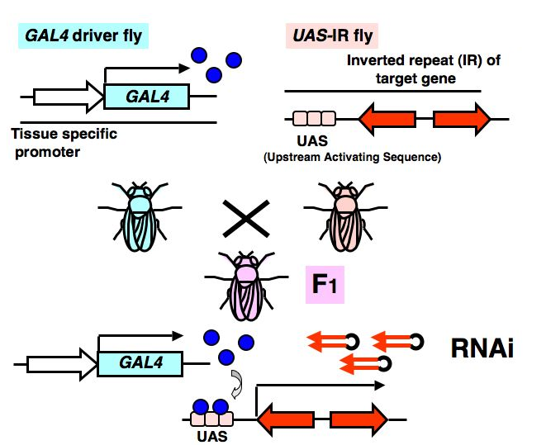
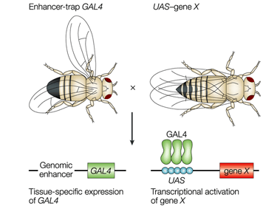
Methods: 4. Functional validation in MetS background
RNAi silencing
Over-expression
Adapted from http://jcggdb.jp & Johnston et al, nat rev gen (2002)
Notes:
I will perform functional validation of putative genes by using genetic tools in Drosophila. The most versatile genetic tool is the
The UAS-GAL4 system which is one of the biggest reasons for using drosphila over other models such as mice. Briefly, it’s a two-part system consisting of fragment of the GAL4 gene. The GAL4 protein binds to UAS, switching on the expression of any construct downstream.GAL4 is under the promotor of interest such as a brain specific promotor. UAS has a contruct of interest such as IR of a gene which express double stranded RNA.

Slide 9
First Expected Results
Metabolic Changes in High Sugar Diet induced model
Circulating levels of Sugars (Glucose and Trehalose)
Whole body Triacylglycerol
Whole body NEFA
Whole body Glycogen

Slide 10
THANK YOU.

